Slide 1


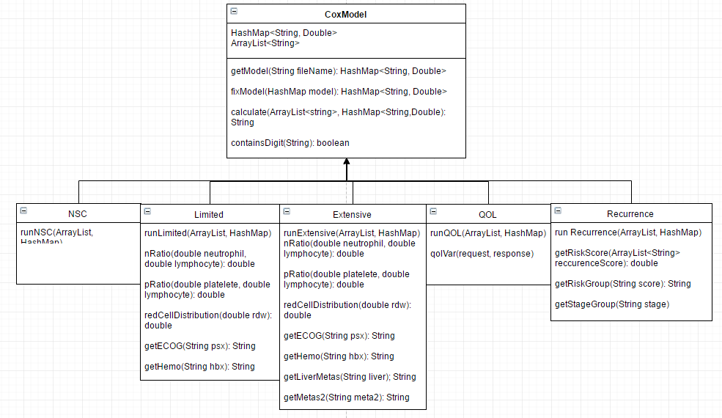
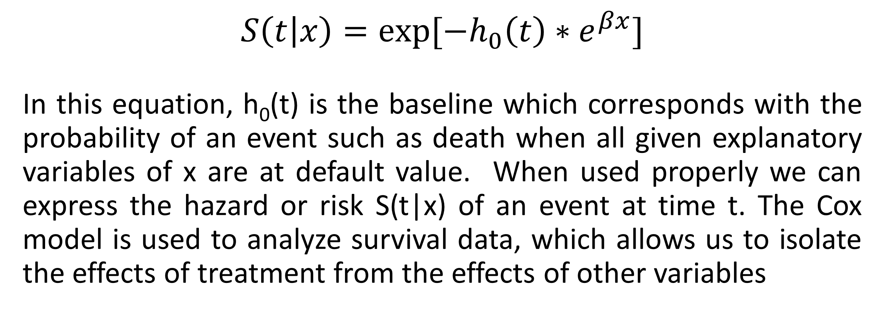
Java Implementation of Cox Proportional Hazard Model
Author: Nathan Martin Advisor: Dr. Mingrui Zhang
Computer Science Department, Winona State University
abstract
Methods
Software Design
Limited availability of statistical analysis functions in Java, including the Cox PH model, limits the Java users to replicate needed functions that are provided by other languages. By creating a function in Java that will replicate the Cox Proportional Hazard Model we can generate accurate results that are comparable to results from other statistical analysis software like R. Rather than being a full statistical package, this project encompasses a generic implementation of the Cox PH model that allows for multiple different models to be used for computing survival analysis data.
I have used Eclipse to develop the Java program, R software to produce the results for comparison, and SPSS to calculate the mean, standard deviations and significance.
COX Proportional Hazard Model
$S\left(t | x\right)={exp⁡[−h}_{0}\left(t\right)∗e^{βx}]$
In this equation, h₀(t) is the baseline which corresponds with the probability of an event such as death when all given explanatory variables of x are at default value. When used properly we can express the hazard or risk S(t|x) of an event at time t. The Cox model is used to analyze survival data, which allows us to isolate the effects of treatment from the effects of other variables
Objectives of the project
To develop a Java implementation of Cox Proportional Hazard Model and use it in web-based user interfaces to predict lung cancer patient treatment outcomes.
results
References
The table below shows the differences between data produced from R and Java implementations of five clinical models. T-test is done using SPSS statistical software.
[1] Walters, Stephen John. What Is a Cox Model? 2nd ed. England: Hayward Medical Communications, 2009. What Is...? What Is a Cox Model. May 2009. Web. 21 Jan. 2016.
[2] Fox, John, and Sanford Weisberg. "Cox Proportional Hazards Regression." Encyclopedia of Public Health 2 (2011): 1-20. 23 Feb. 2011. Web. 21 Jan. 2016.
[3] Spatz, Chris. Exploring Statistics: Tales of Distributions. 11th ed. Conway: Outcrop, 2016. Print.
[4] Edelstein, David, and Justin Scheiber. "The Fnordistan Department of Software Engineering." JStats. N.p., n.d. Web. 28 Jan. 2016.
[5] Campagne, Fabien. "Campagne Laboratory." BDVal - Campagnelab. Well Medical College of Cornell University, 4 Aug. 2010. Web. 10 Feb. 2016. http://campagnelab.org/software/bdval/.
[6] Urbanek, Simon. "Low-Level R to Java Interface." (2016): 1-45. Cran R Project. Web.
T-test Results (R vs. Java) | Mean | Std. Deviation | Std. Error Mean | Sig (2-tailed)
Background | 0 | 0 | 0 | 0
Limited | -0.00329 | 0.00677 | 0.0093 | 0.001
Extensive | -0.00473 | 0.01251 | 0.00193 | 0.019
QOL | -0.00902 | 0.00537 | 0.00069 | 0
Recurrence | -0.00386 | 0.00981 | 0.00149 | 0.014
Conclusion
The replacement of the R implementation of Cox Proportional Hazard Model with our Java implementation simplifies and streamlines the future design of Web-based Software Tool in predicting cancer treatment outcomes.

